Slide 1

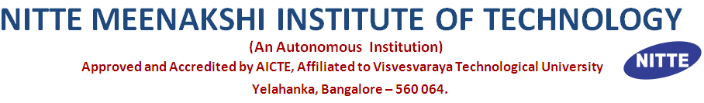
PROJECT PRESENTATION FOR DNP COMPANY
NAME---- NISHANTH D KINI
USN----1NT19IS100
9.24.XX

Slide 2
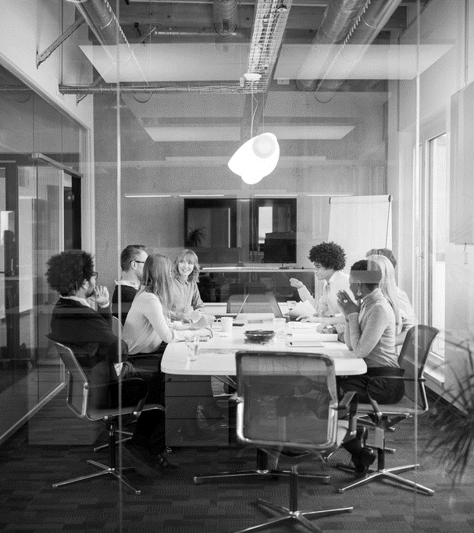
Agenda
INTRODUCTION
WORKING
SCREENSHOTS

Slide 3
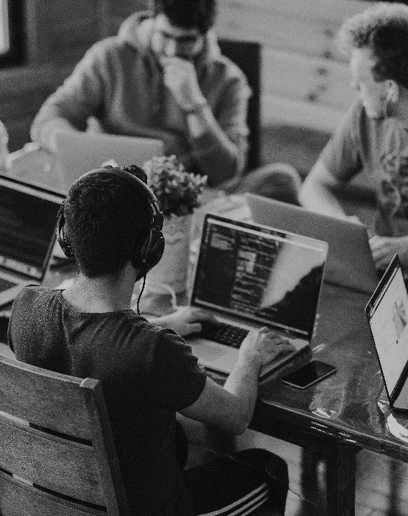
INTRODUCTION
WEATHER BOT USING COMPOSER
Here is a weather bot which can give the weather of a particular place . I have used the Bot Framework Composer. Initially the echo bot was created on Microsoft Azure using the Azure Bot Service but since from October 1 , 2022 those services have been deprecated along with the QnA maker the suggestion from Microsoft was to use the Bot Framework Composer to demonstrate the bot.

Slide 4

SCREENSHOTS
Let’s Dive In

Slide 5
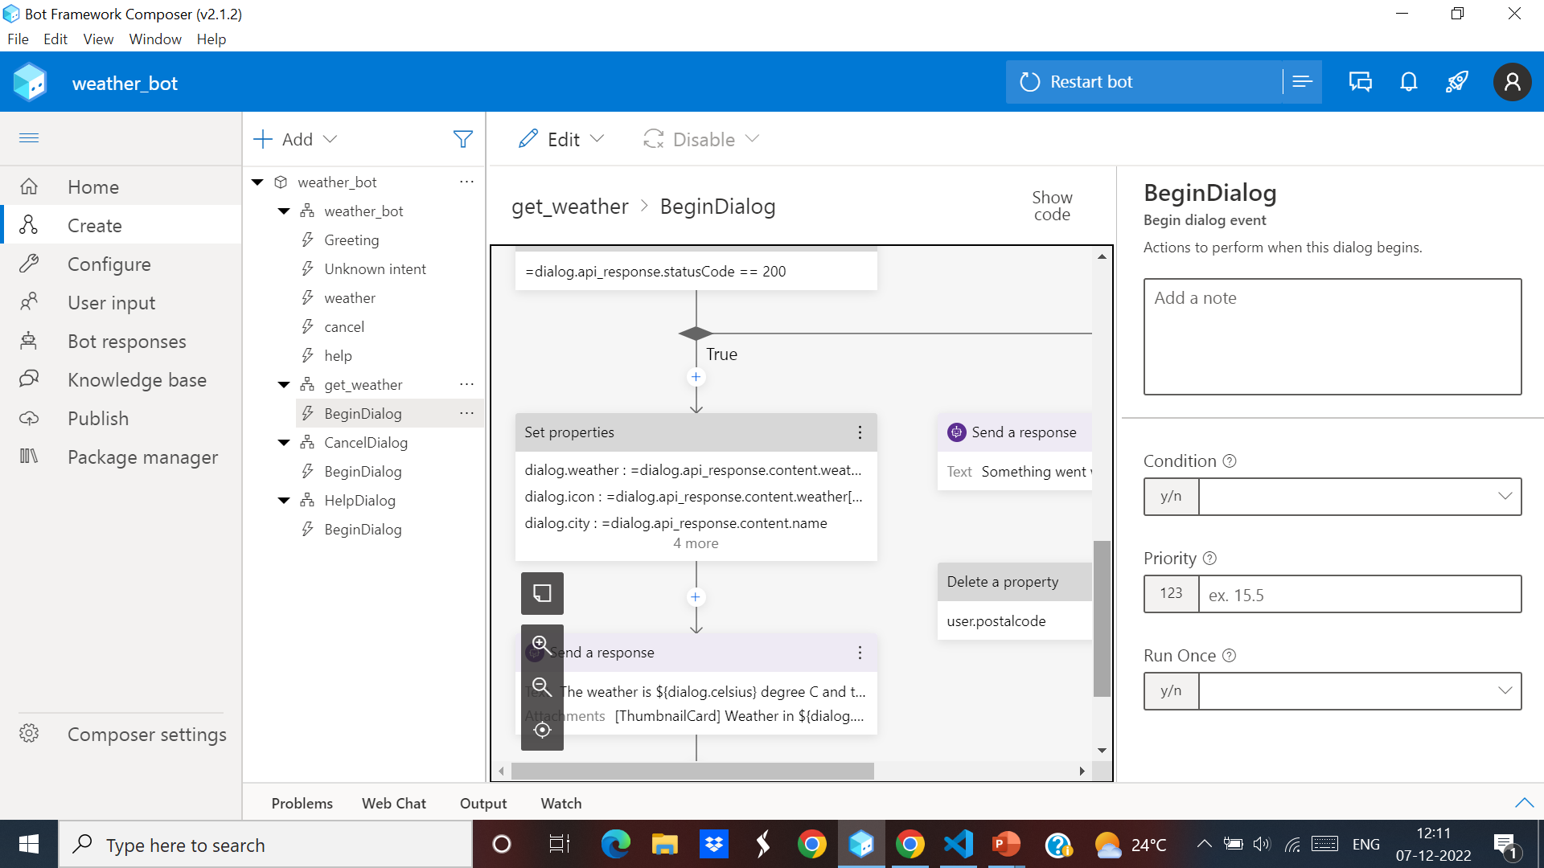
AUTHORING CANVAS

Slide 6
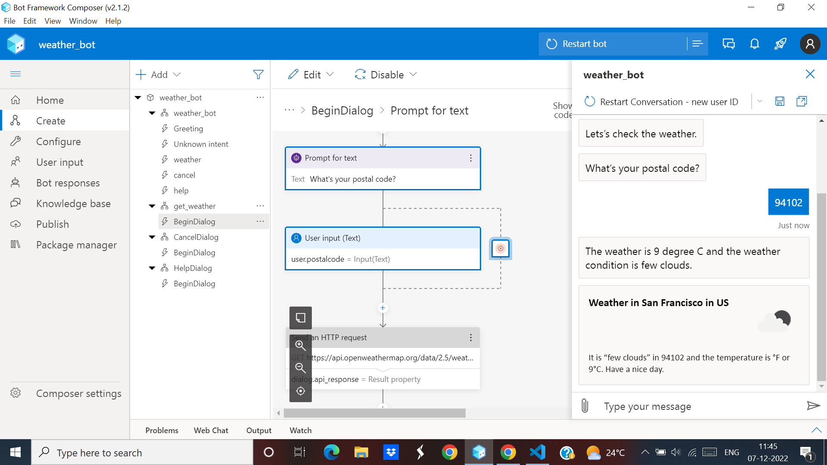
WEATHER BOT IN ACTION

Slide 7



THANK YOU
NISHANTH KINI
+91 7795883750
nishanthkini27@gmail.com
WORK BETWEEN SMARTNESS AND HARDNESS

